Slide 1

Classifying Song Genres from Audio
This presentation covers a NLP project focused on classifying song genres from audio data using machine learning.

Slide 2

Introduction
Music Streaming
Project Goal
Feature Analysis
Music streaming platforms provide access to vast music collections, but effective genre classification is crucial for personalized recommendations.
This project focuses on classifying songs as Hip-Hop or Rock using machine learning techniques.
Features derived from Spotify track information are analyzed to determine their impact on genre classification.

Slide 3
Dataset Overview
Data Source
Feature Set
Labels
Data Formats
The data used in this project was sourced from The Echo Nest, a platform for music analysis and discovery.
The dataset contains numerical features like danceability, energy, and acousticness, providing insights into the sonic characteristics of songs.
Each song is labeled as either Hip-Hop or Rock, providing the target output for classification.
The data is available in CSV and JSON formats, allowing flexibility in data processing and analysis.

Slide 4

Data Preprocessing
1
The features and labels were merged into a single dataset for easier analysis.
2
Missing values were handled and data inconsistencies were resolved to ensure data quality.
3
Data was normalized using standardization to create a consistent scale for all features.
4
Pairwise feature relationships were explored to identify and remove redundant features.

Slide 5
Principal Component Analysis (PCA)
Dimensionality Reduction
Feature Importance
Component Selection
PCA was used to reduce the dimensionality of the feature space, simplifying the analysis without sacrificing important information.
PCA identifies features contributing most to variance, providing insight into the key factors influencing genre classification.
Scree plots and cumulative explained variance were used to determine the optimal number of principal components to retain.

Slide 6
Model Selection
Decision Tree
Logistic Regression
Performance Comparison
A rule-based classifier that is easy to interpret and understand, making it suitable for explainability.
A probability-based classifier that uses a linear model to estimate the probability of belonging to a specific genre.
Both models were trained and their performance was evaluated based on accuracy and precision.

Slide 7
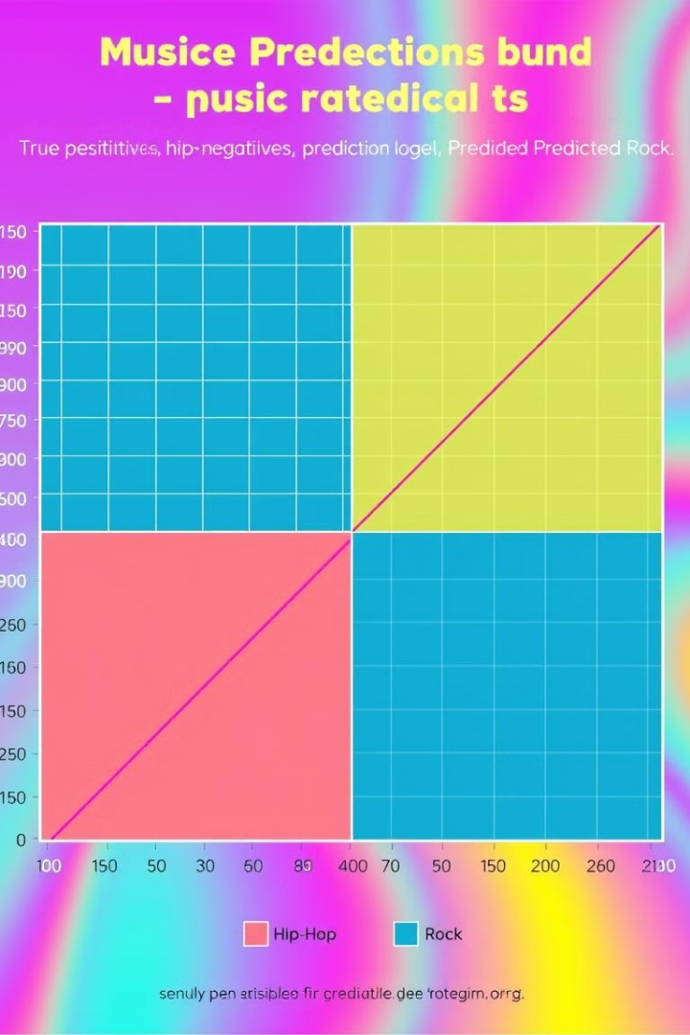
Model Evaluation
Confusion Matrix
Initial Results
Confusion matrices were used to visually analyze the performance of each model.
Both models achieved an initial accuracy of around 87% but showed a slight bias towards misclassifying Hip-Hop.
Data Balancing
This observation highlighted the need to address class imbalance within the dataset to improve model performance.

Slide 8
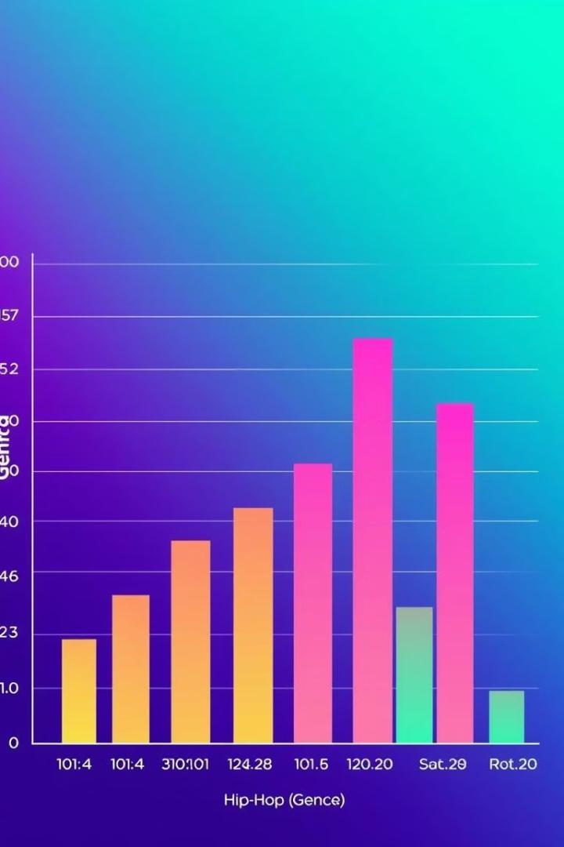


Handling Class Imbalance
The dataset contained a higher number of Rock songs compared to Hip-Hop songs, leading to potential bias in model training.
Class weighting was applied to balance the importance of each genre during model training, reducing bias and improving classification accuracy for Hip-Hop.

Slide 9
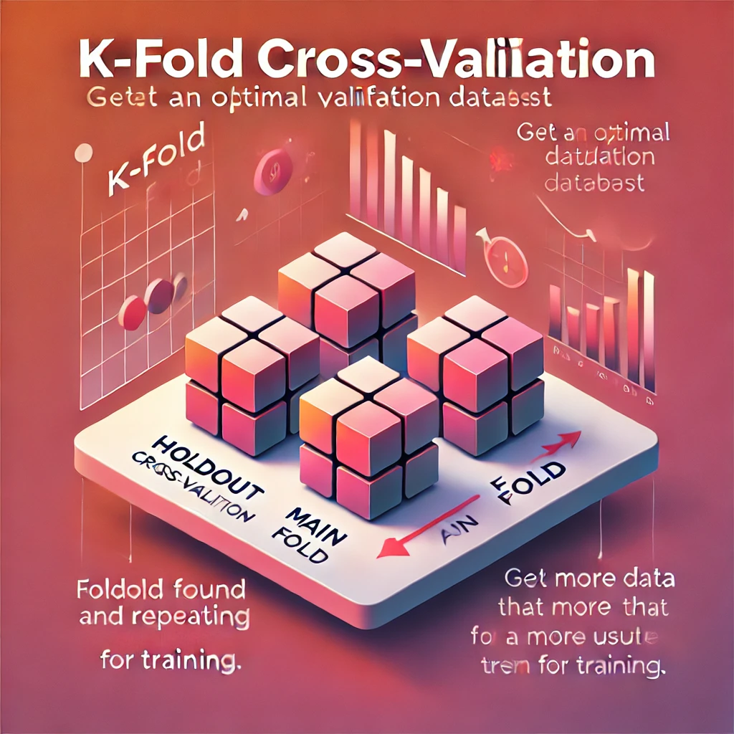
Cross-validation (K-Fold)
1
K-Fold Cross-validation was used to evaluate the models further, ensuring their generalization to unseen data.
2
This technique divides the data into K subsets, training on K-1 folds and testing on the remaining fold, repeating this process K times.
3
It helps avoid overfitting by testing on multiple subsets of the data, providing a more robust assessment of model performance.

Slide 10





Conclusion & Future Work
This project successfully classified songs into Hip-Hop and Rock genres using machine learning techniques.
PCA was effective in reducing dimensionality, while maintaining accuracy.
Decision Tree and Logistic Regression models showed similar performance, achieving approximately 87% accuracy.
Future work includes expanding the project to classify more genres and exploring the use of deep learning models.

